Slide 1
Working with JSON
JavaScript Object Notation (JSON) is a standard text-based format for representing structured data based on JavaScript
object syntax. It is commonly used for transmitting data in web applications (e.g., sending some data from the server
to the client, so it can be displayed on a web page, or vice versa). You'll come across it quite often, so in this article, we
give you all you need to work with JSON using JavaScript, including parsing JSON so you can access data within it, and
creating JSON.

Slide 2
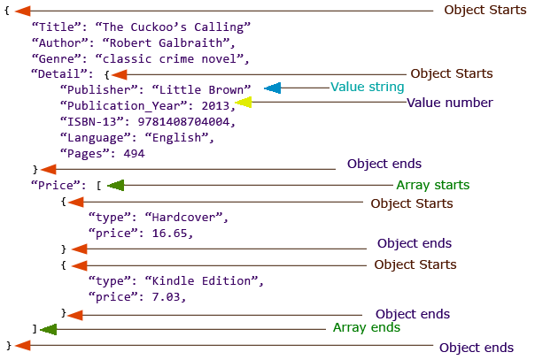
JSON structure

